Slide 1


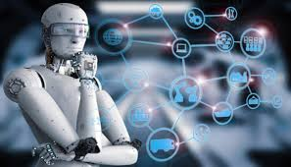
AMIT
GRADUATION PROJECT
CONTROLLING CAR WITH HAND MOTION

Slide 2





The aim of the project
W I R E L E S S L Y C O N T R O L L I N G A C A R ' S S P E E D A N D D I R E C T I O N W I T H
H A N D M O T I O N

Slide 3
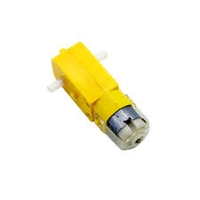
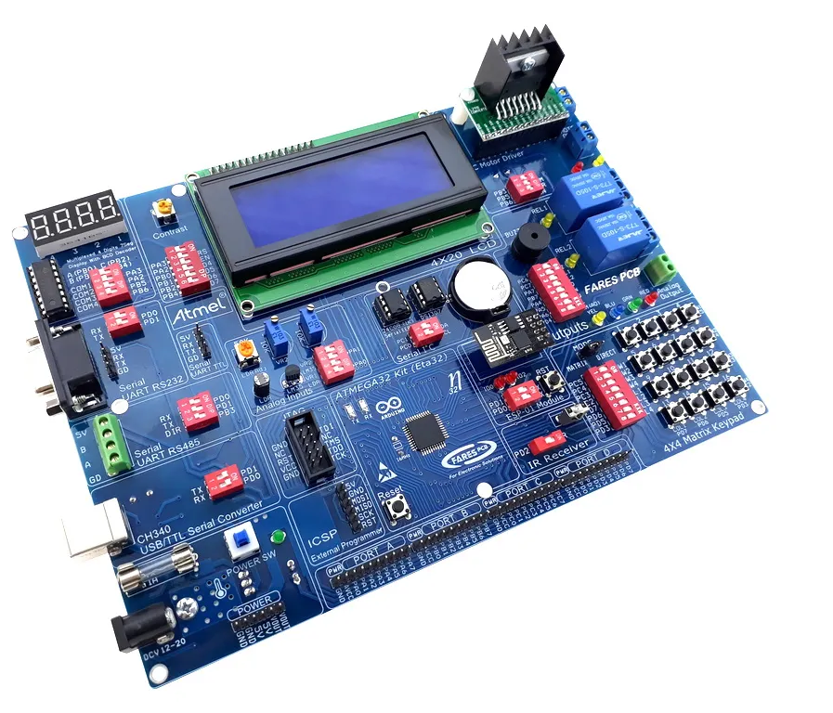
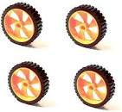
COMPONENTS
1. 2x ATMEGA32A
2. 5x flexible sensors
3. Gloves && Wires.
4.2xBattery3.7V.
5.LM7805
6. 2x HC-05.
7. L293D.
8. Motors.
9. Caster wheel.
10. Chassis

Slide 4
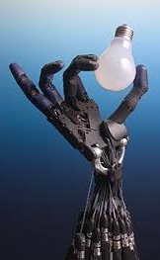
The idea of integration of hand module and car module
AS we previously explained that we use flexible sensor to translate finger motion to a corresponding resistance value that will be insertedin an electrical circuit and by using voltage divider we get certain output voltage to every corresponding resistance of the flexible sensor as we bent or unbent the finger

Slide 5
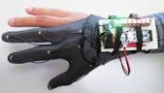
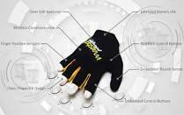
The output voltage of the electrical circuit will be the input of the ADC in our kit in hand glove module so that it converts the analog signal to a digital signal that we will be able to process our system based on this input.
We will define certain range of values that will correspond to a certain character that will be sent to the motor in the car module to perform certain movement (RIGHT – LEFT – FORWARD – BACKWARD ) And will provide characters sent to the car module to control speed of the motors.

Slide 6
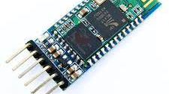
THE BLUTOOTH MODULE WILL SEND DATA FROM HAND GLOVE MODULE (MASTER) TO CAR MODULE (SLAVE) USING UART SERIAL COMMUNIACTION PROTOCOL .

Slide 7
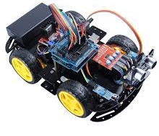
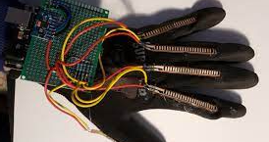
IN THE CAR MODULE THE MOVEMENTS THAT WILL BE PERFORMED DEPENDS ON THE DATA RECEIVED FROM THE HAND GLOVE MODULE.
MOVEMENT OF THE TWO MOTORS IS CONTROLLED BY THE MOTOR DRIVER
SPEED CONTROL IS DONE USING PWM (PULSE – WIDTH – MODULATION) BY CHANGING ITS DUTY CYCLE TO CONTROL SPEED AND OTHER 2 PINS FOR THE DIRECTION.

Slide 8

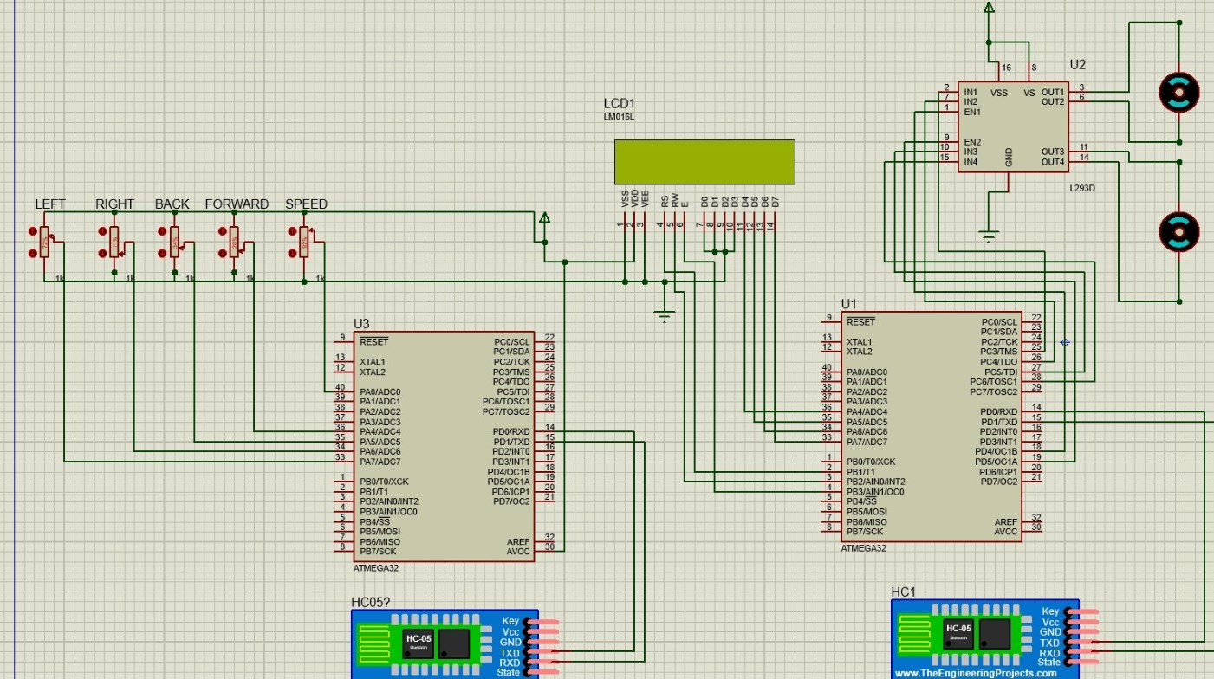
SIMULATION OF THE CIRCUIT

Slide 9
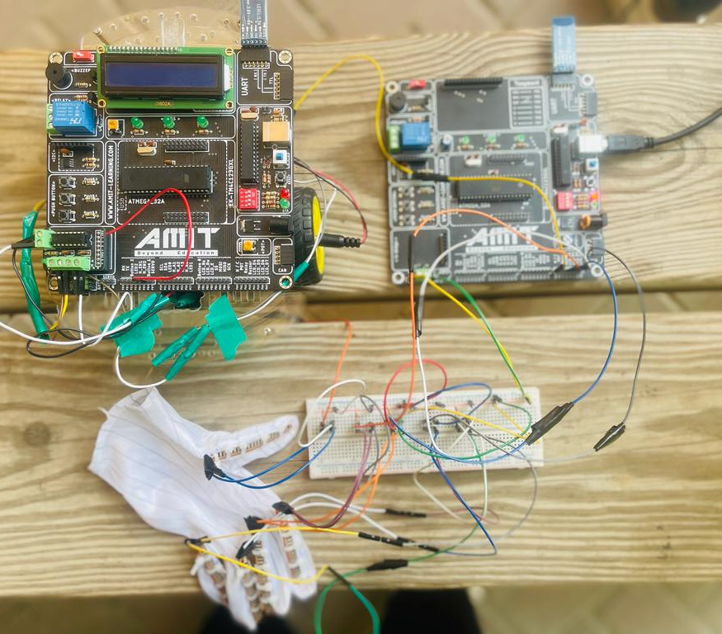
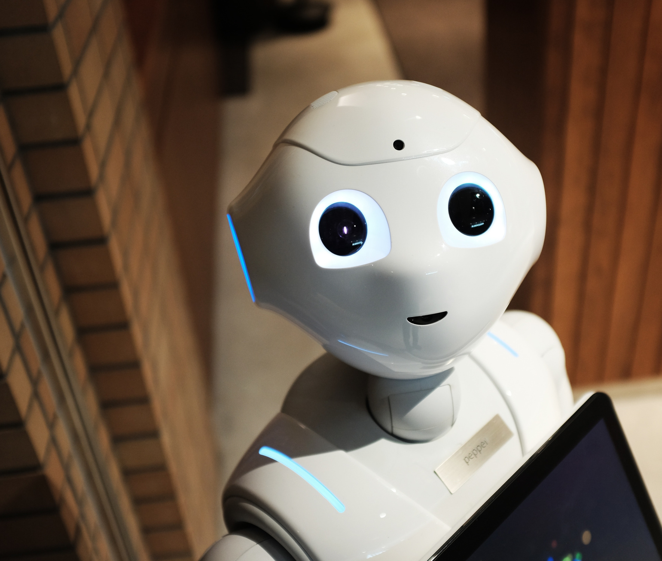
LIVE PICTURE OF THE PROJECT

Slide 10
THANK YOU

